Slide 1



UNIT 3
LESSON 12
Looking forward to the future
Part 1

Slide 2
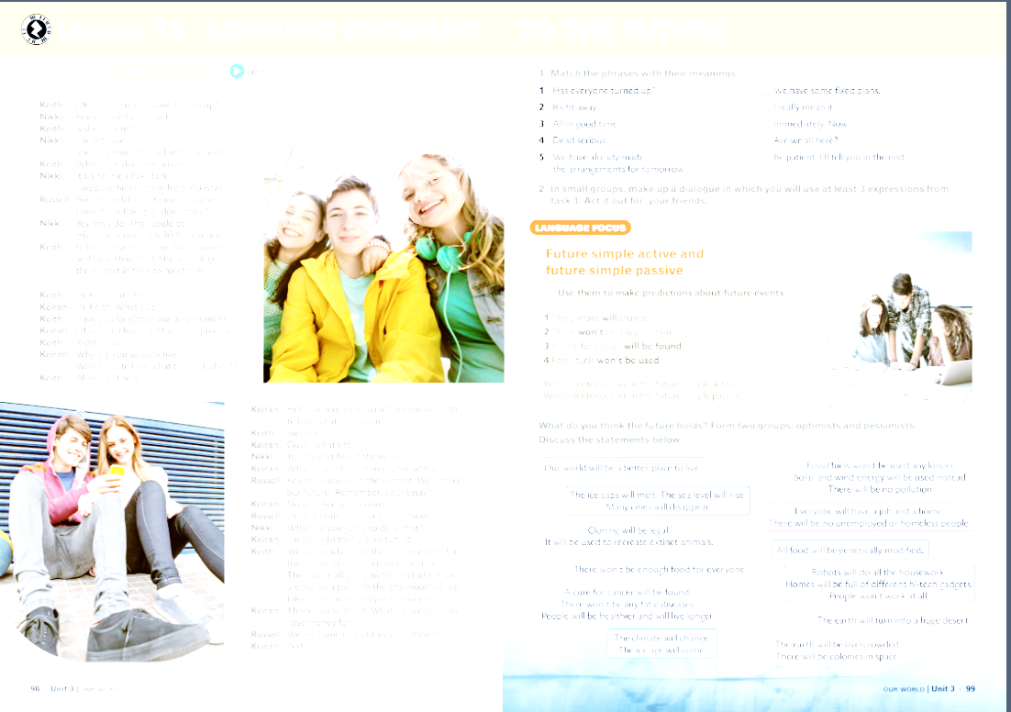
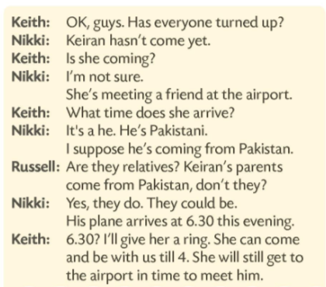
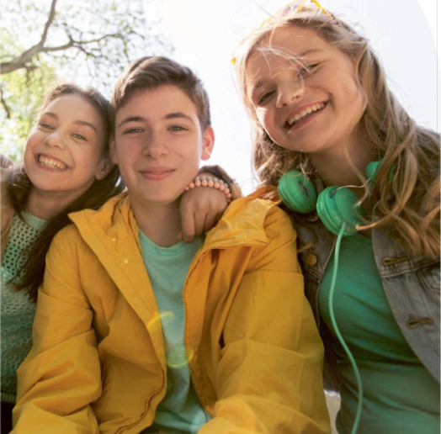

Has everyone turned up?
Right away.
All in good time.
Dead serious.
We have already made the arrangements for tomorrow.
You haven’t heard the news?
Why are you so secretive?

Slide 3
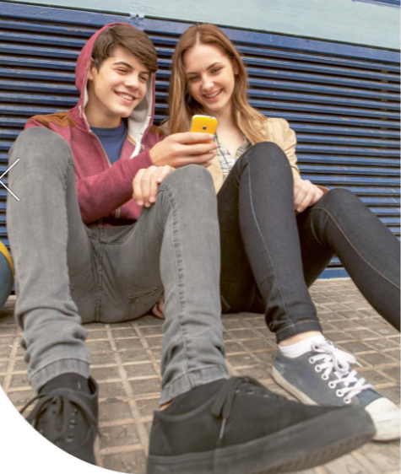

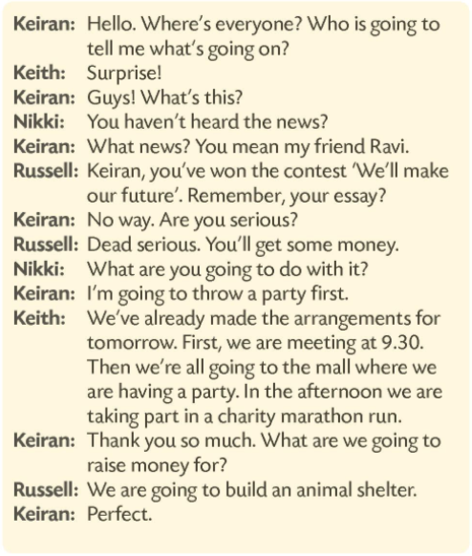
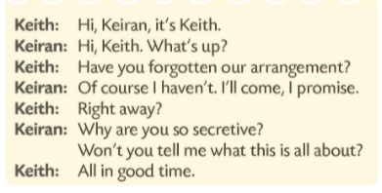

Slide 4
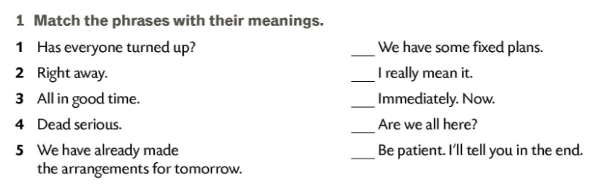
5
4
2
1
3
There are four ways of expressing the future used in the Teenspeak dialogues. Read the dialogues and find an example for each of them:
Predictions and promises - Intentions - Future plans and arrangements - Timetables and arrangements

Slide 5
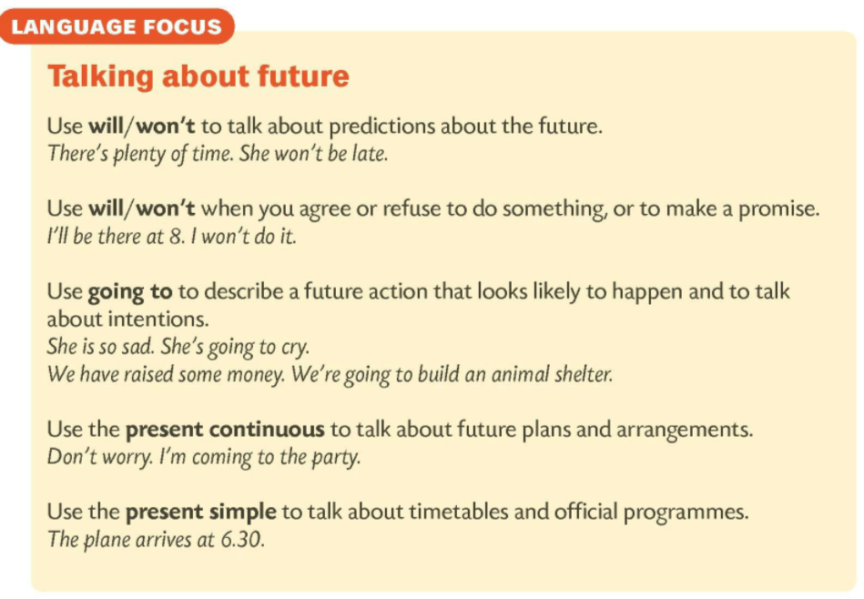
Predictions and promises
I’ll come, I promise.
Intentions
I’m going to throw a party first.
Future plans and arrangements
She’s meeting a friend at the airport.
Timetables and arrangements
His plane arrives at 6.30 this evening.

Slide 6
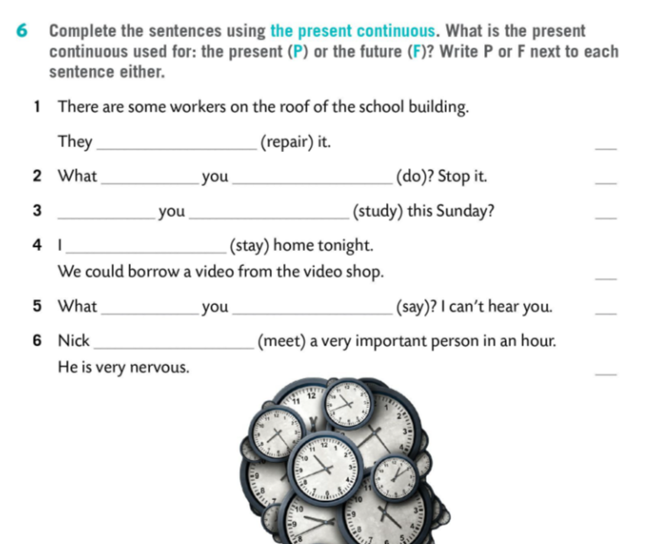
are repairing
P
are
doing
P
Are
studying
F
am staying
F
are
saying
P
is meeting
F

Slide 7
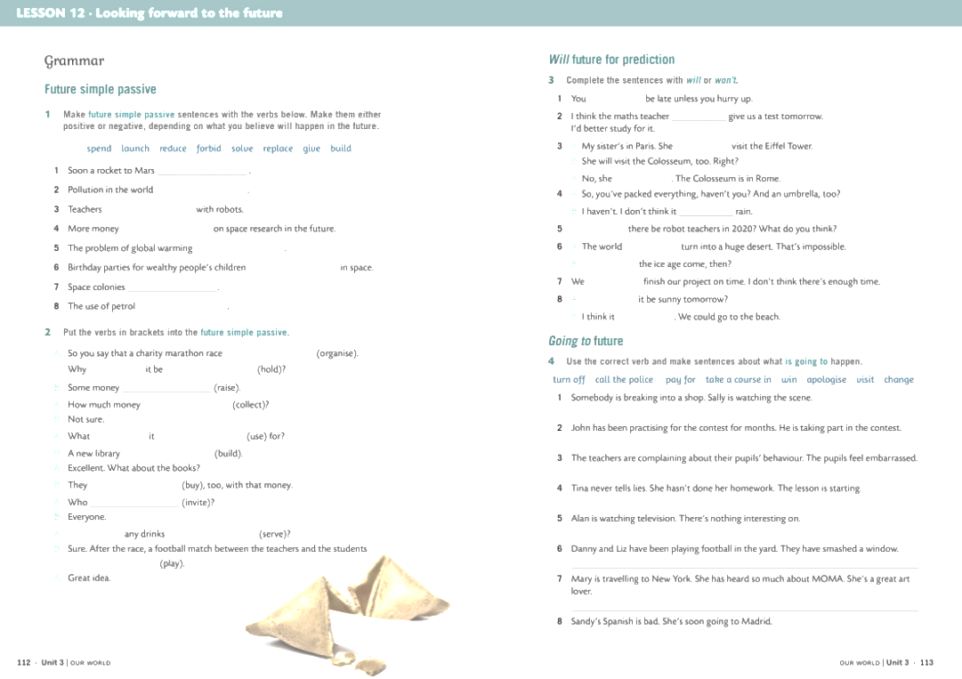
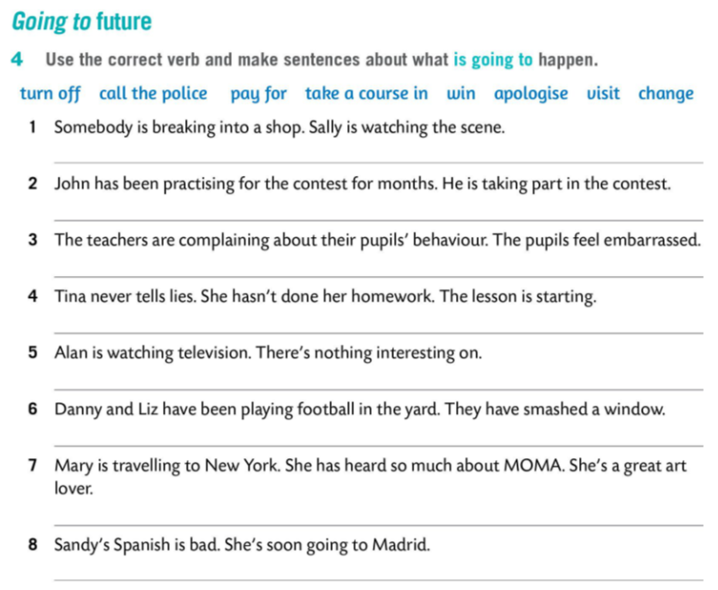
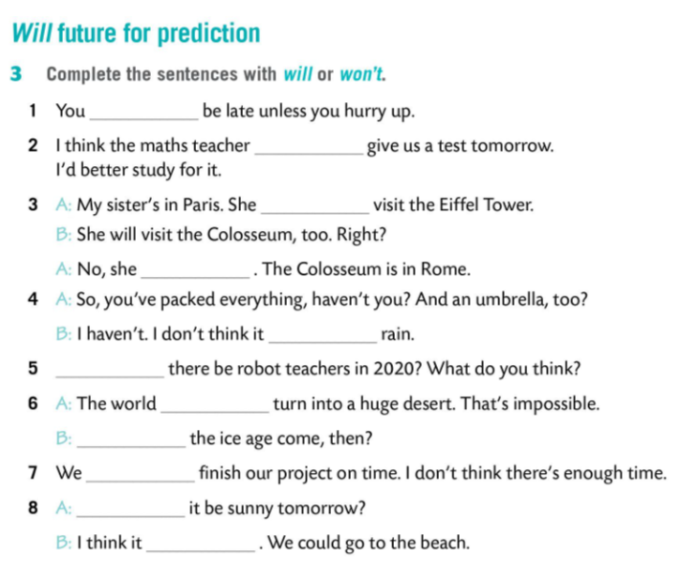
Sally is going to call the police.
John is going to win.
will
The pupils are going to change their behaviour.
will
Tina is going to apologise.
will
Alan is going to turn the TV off.
won’t
Danny and Liz are going to pay for it.
will
will
Mary is going to visit MOMA.
won’t
will
Sandy is going to take a course in Spanish.
won’t
won’t
will

Slide 8
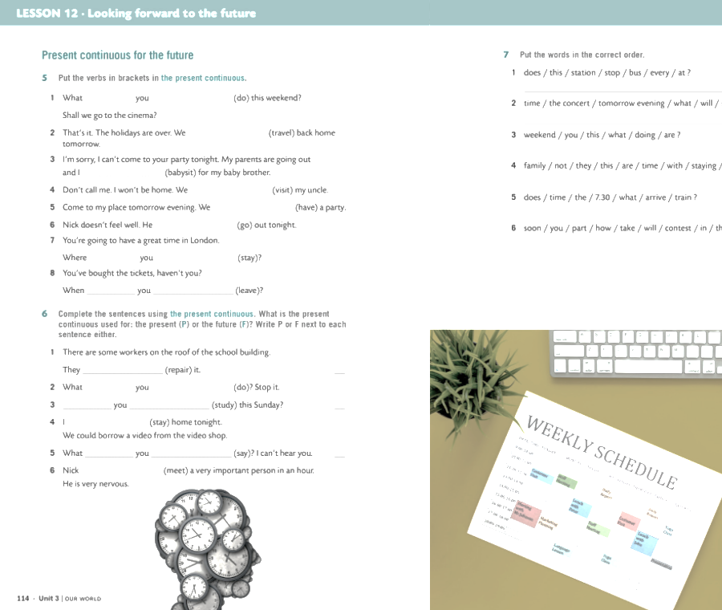
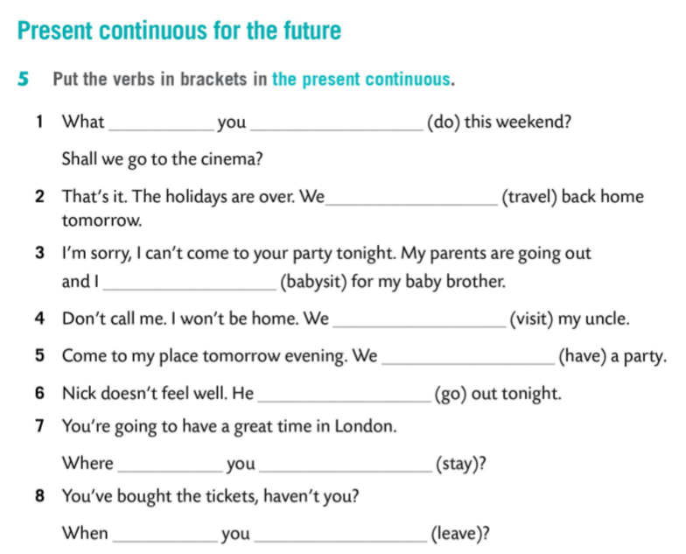
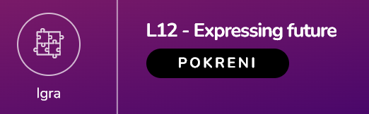
are
doing
are travelling
am babysitting
are visiting
are having
is not going
are
staying
are
leaving

